Slide 1
Data science project
Presentation

Slide 2


Problem definition
- In this project I had to get data from two sites doing filtration then compare and trying to analyze how they get the original data from the whole data. - I must do some search to overcome the obstacles that faced me.

Slide 3
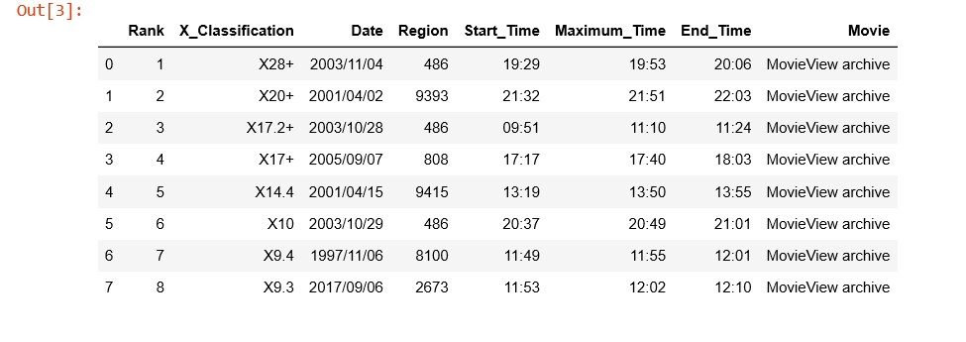
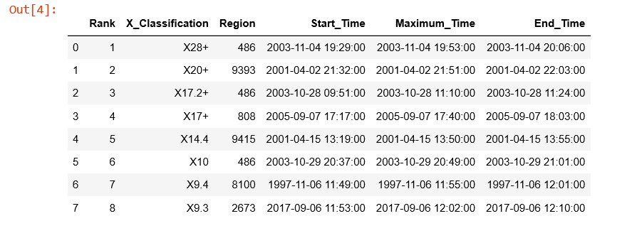
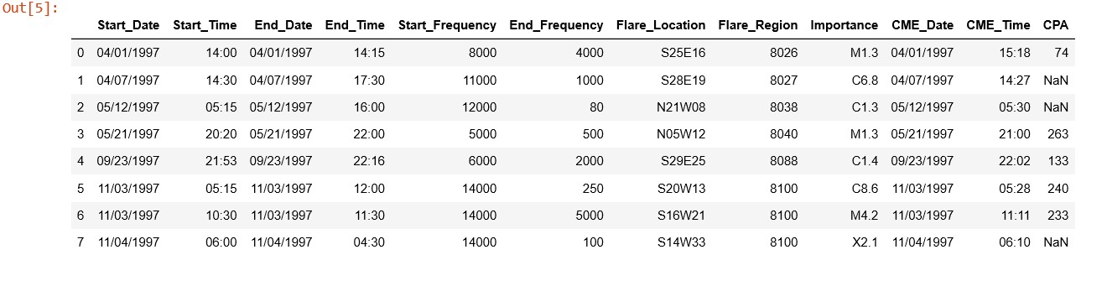
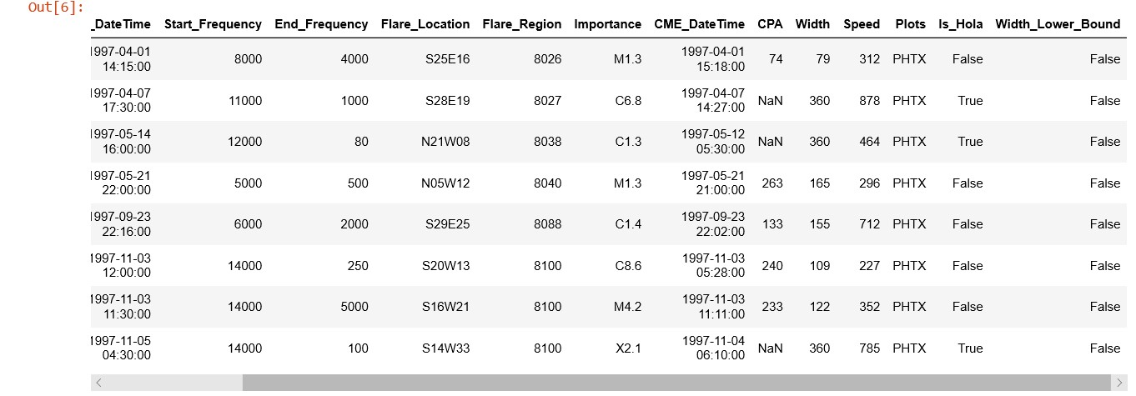
Part 1 : Data scraping and preparation
Step 2: Tidy the top 50 solar flare data
Step 1: Scrape your competitor's data
Step 3: Scrape the NASA data
Step 4: Tidy the NASA table

Slide 4
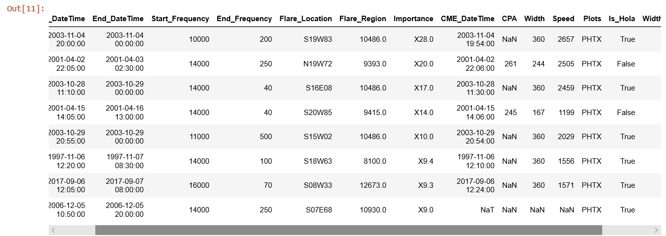
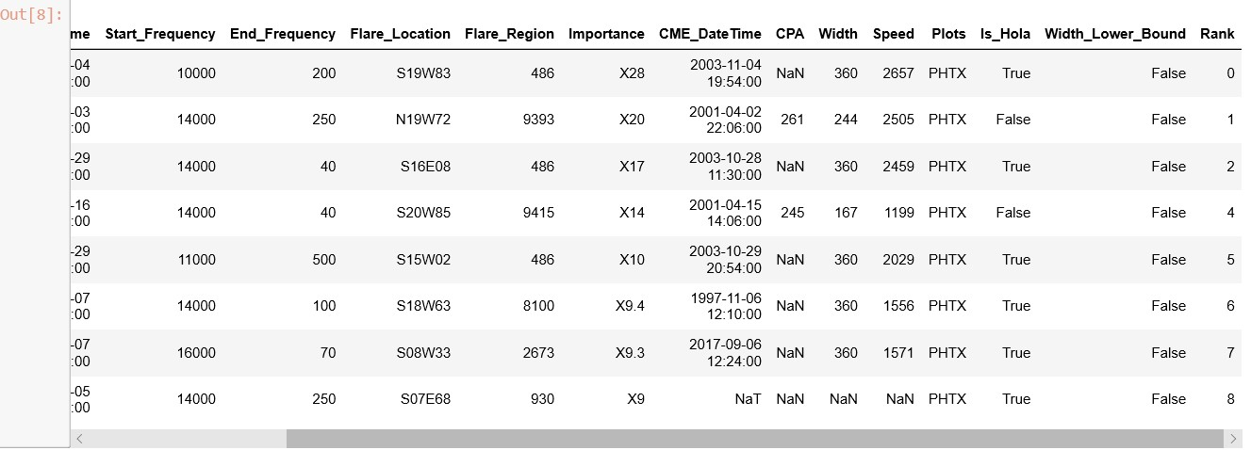
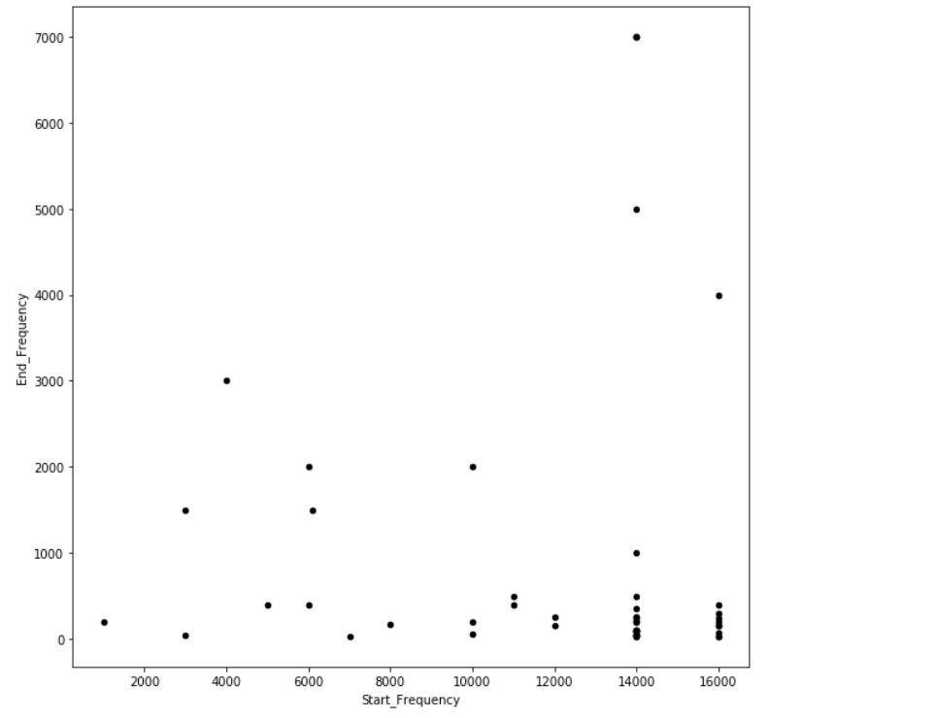
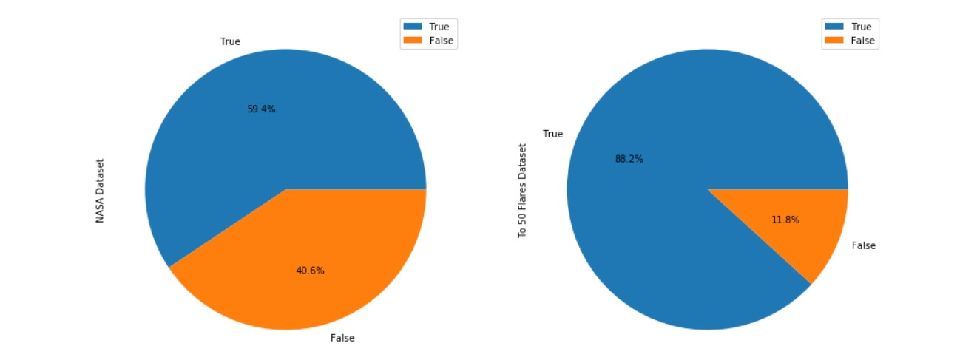
Part 2: Analysis
Question 1: Replication
Question 2: Integration
Question 3: Analysis

